Slide 1

CS3423 Compilers-II
Dr. Jyothi Vedurada
ConcurrX
Parallelized, Threaded, and Graphed for Performance Brilliance.
Project Manager: | Varshini Jonnala
Language Guru: | Anudeep Rao Perala
System Integrator: | Tushita Sharva Janga
System Architect: | Narsupalli Sai Vamsi
Tester: | All

Slide 2
ConcurrX
Outline
Introduction
Compiler Architecture
Lexer
Interface
Parser
Execution Flow
Example

Slide 3
.
A language tailored for developers focusing on parallel computing and performance analysis
It provides built-in features to parallelize tasks efficiently across multiple threads.
The language includes tasks for benchmarking, allowing users to compare the execution time of them across different thread numbers.
It supports smooth inclusion with popular parallel computing libraries, making it straightforward for the developers to use the existing tools and resources efficiently.
Introduction

Slide 4
ConcurrX
COMPILER ARCHITECTURE

Slide 5
.
We are using the Module-Interface architecture in our compiler for the DSL.
The architecture is as follows:
A distinct and encapsulated unit of the compiler design that is responsible for a specific aspect of the compilation process called as “module”
An “Interface” between every 2 modules, which acts as a point of communication between those 2 modules which defines how the information flows between the modules
The input stream gets processed in the modules, flows through the interface after processing and finally we get the output .
In these phase, we have 2 modules and 1 interface. They are Lexer, Parser and the TokenFlowNexus
Compiler Architecture

Slide 6
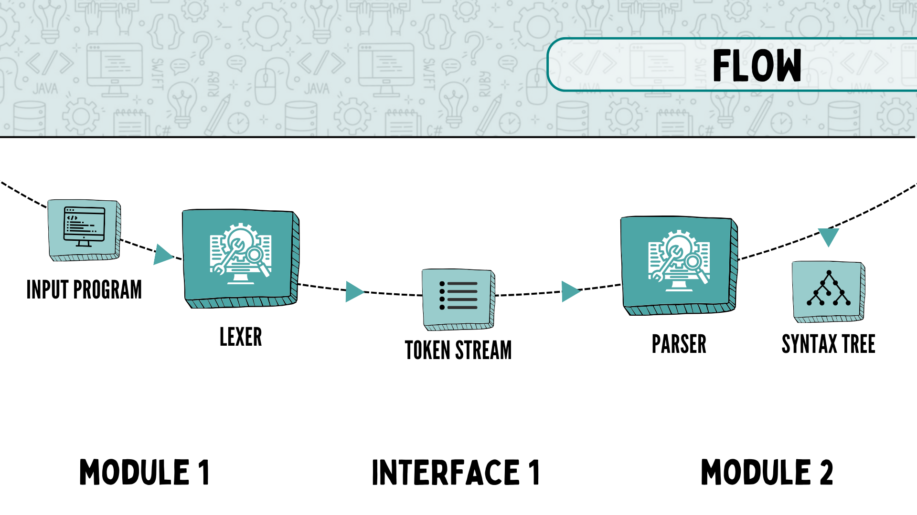

Slide 7
ConcurrX
MODULE 1: LEXER

Slide 8
.
This module of our compiler reads the input source code and breaks it down into meaningful fragments called tokens
Tokens represent the smallest units of meaning within the code. They are categorized elements, that has a specific role in the syntax and semantics of the programming language.
The lexer's main role is to transforms the raw code into a token stream and then returns these tokens to the next module through the interface
It does so by reading the source code character by character and groups them into meaningful chunks based on the regular expressions that we define.
The lexer

Slide 9
.
The lexer receives the .cx file as an input
It removes the comments and white spaces
Converts the file into a stream of tokens
It returns all the valid tokens to the next module using the interface
An error would be returned as a LEX_ERROR token which would stop the tokenizing and parsing
The following are the different types of tokens that we have defined for our language.
It also outputs a tokenstream file, which contains all the different
What does our lexer do

Slide 10
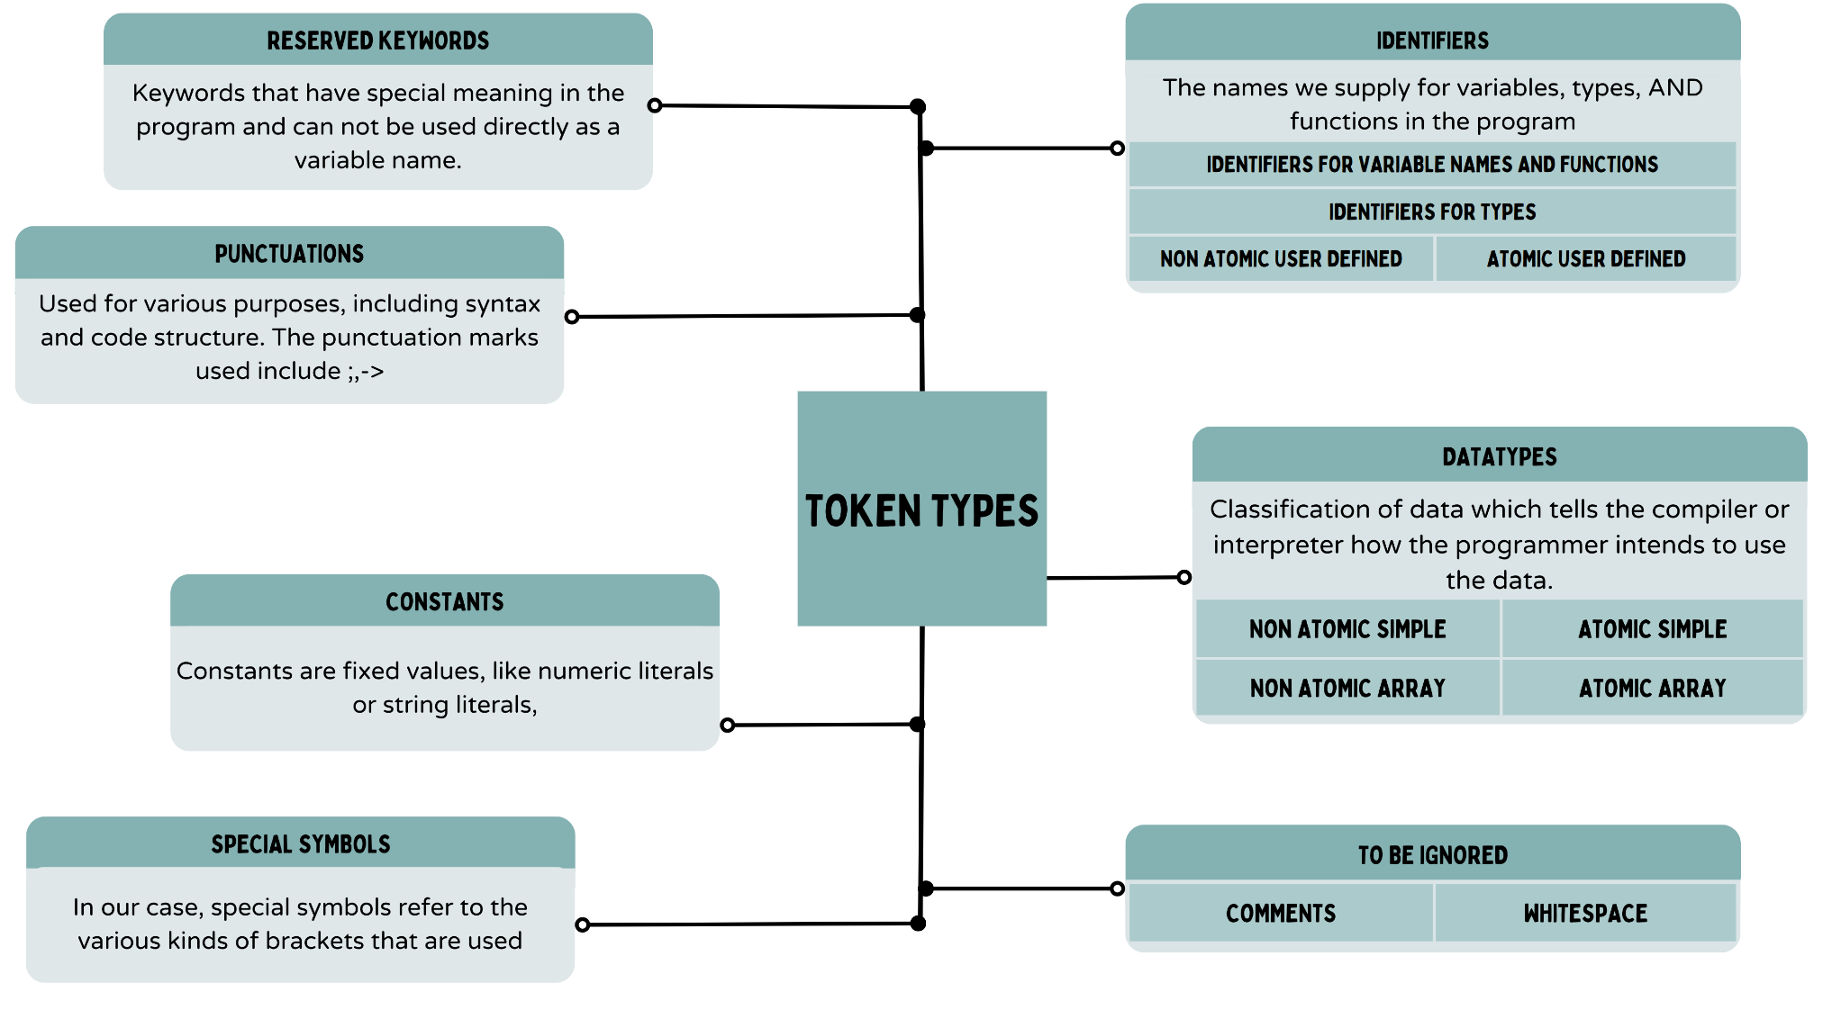

Slide 11
.
Each of the above defined tokens are recognized through the patterns that we have specified in the rules section of the lex.l file
Rules are expressed using the regular expressions.
Once the sequence is matched with a given regular expression according to the precedence given, the corresponding C++ functions would be executed and corresponding token is returned
We write our lexical analyzer in flex and we use the following libraries for running it
Libraries used in lex.l :
1. cpp iostream, unordered_set, string
2. We include bison.tab.h for importing the token types
How does our lexer works

Slide 12
ConcurrX
INTERFACE 1: LEXER-PARSER INTERFACE

Slide 13
.
The interface acts as a communication link between the lexer and parser.
Once the lexer has categorized the source code into tokens, the interface becomes the bridge for passing of these organized stream of tokens to the parser
It ensures that the parser receives a well-defined set of language elements, allowing it to perform its syntax analysis effectively
It involves a set of functions or methods that allow the parser to request the next token from the lexer and get to know about the type of the current token (Check this line once)
The Interface

Slide 14
ConcurrX
MODULE 2: PARSER

Slide 15
.
This module of our compiler transforms the organized tokens from the lexer into a structured blueprint, which would be used in further steps of compilation.
It ensures whether the arrangement of tokens follows the grammar rules of the programming language
The parser builds a tree called the Abstract Syntax Tree (AST) that shows how different parts of the code relate to each other. It helps the compiler understand how the code is put together.
The following are the different sets of rules that we have come up for our DSL.
The Parser

Slide 16
.
The parser gets its tokens as input from the lexer file, through interface
It contains predefined set of tokens that it accepts, by including bison.tab.h
We used bison for generating our parser
The parser contains grammar rules, these rules dictate how the code should be structured
It then checks whether the token stream can be produced from the grammar rules
Each of the grammar rules in the parser would help us in building the parse tree by checking whether it can be produced by one of the given rules
The parser then converts the input token stream into an Abstract Syntax Tree(AST)
Any error in the syntax would then be outputted to the standard output
The following is the basic syntax tree that we get after parsing
How does our Parser works

Slide 17
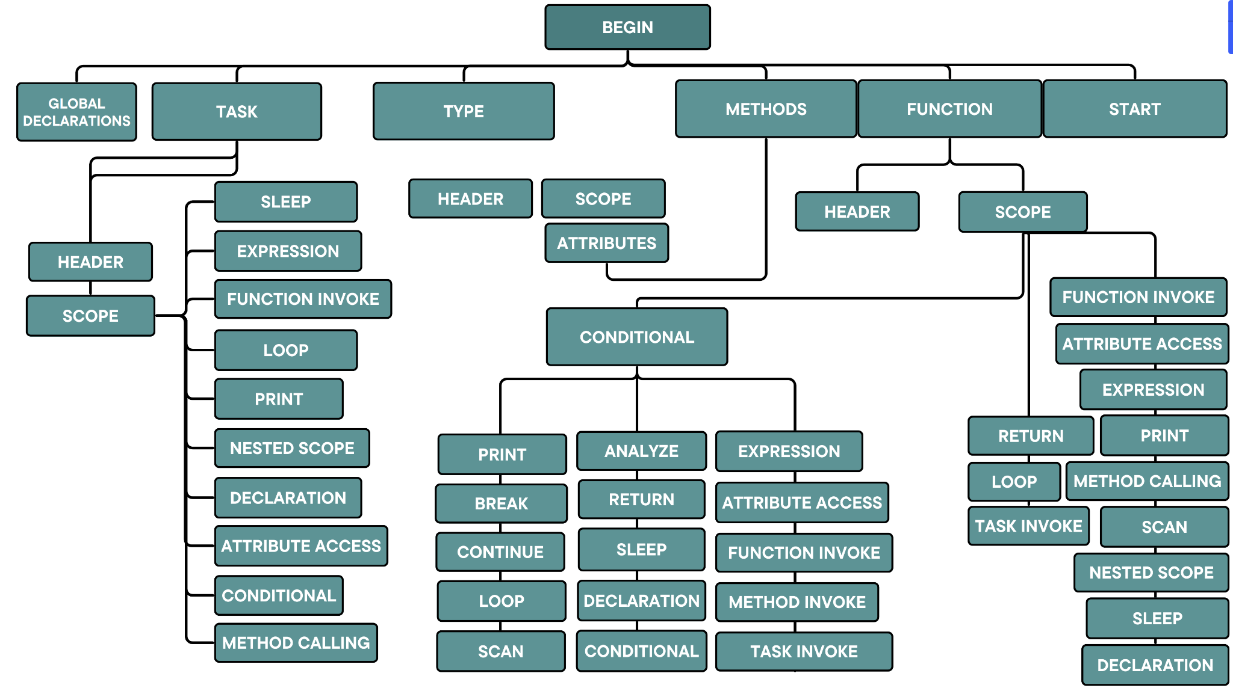

Slide 18
ConcurrX
Execution Flow
We run the bash file which contains the following order of execution
flex lex.l : running the lex file would generate lex.yy.c
bison bison.y : running the parser file which would output bison.tab.c and bison.tab.h
The bison.tab.h file will be used in lex.yy.c
g++ -c main.cpp : running this file would generate main.o
g++ -o lex.yy.c bison.tab.c main.o -lfl : Finally running this command would generate a compilers as an executable which tokenizes and parses the input source code
./exe 1: We run this executional file/Compiler together with the input, which outputs a tokenized file, a parsed file and also points out any errors in our source code by checking whether the program fits each and every rule of the language
$ flex lex.l
$ bison -dtv bison.y
$ g++ -c main.cpp
$ g++ -o exe lex.yy.c bison.tab.c main.o -lfl
$ ./exe 1

Slide 19
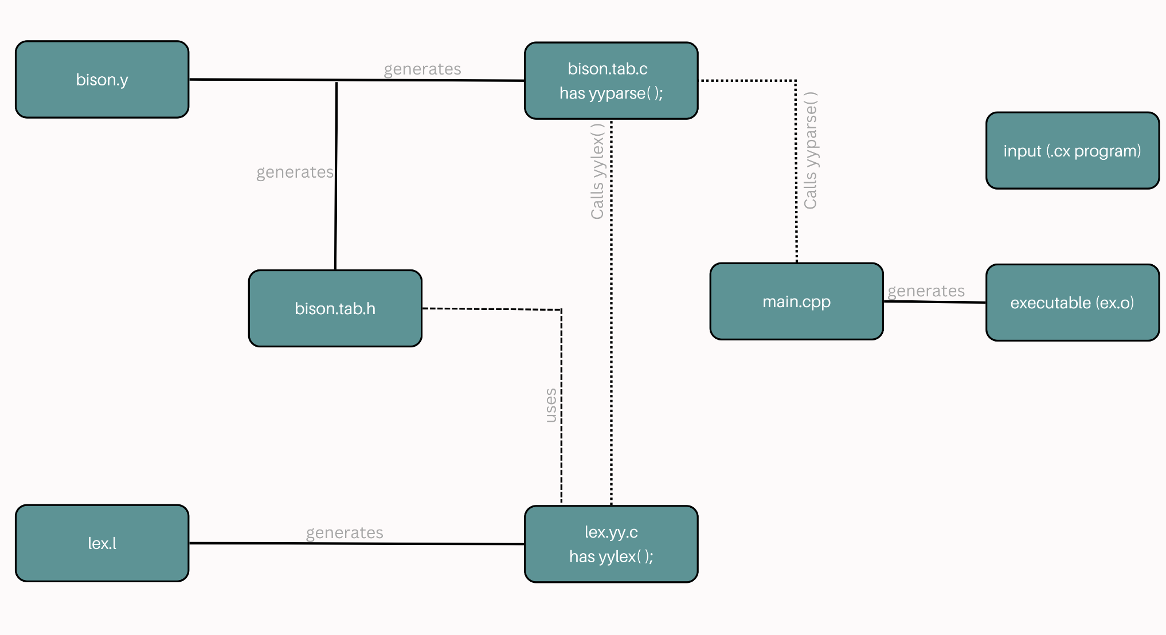

Slide 20
Notes:
COLOUR PALETTE

